Slide 1

EMOTION DETECTION
Francesco ZIngariello
Vittoria Acampora

Slide 2
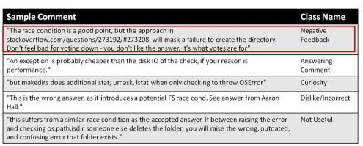
DATASET
We are going to analyze comments collected from StackOverflow in order to create an ameotion classifier .
From the Emotions_GoldStandard_andAnnotation.xlsx. we extracted a .csv file for each emotion that we want to detect: anger, fear, joy, love, sadness, surprise.
We have the same sentences over the 6 csv files. In each of them, in the label column, we have the name of emotion if it is related to the sentence, or NaN otherwise.

Slide 3
PRELIMINARY PHASES:
DATA ANALYSIS
FEATURE EXTRACTION
CORE PHASES:
TEXT MINING PIPELINE
CROSS VALIDATION
CLASSIFIER COMPARISON

Slide 4
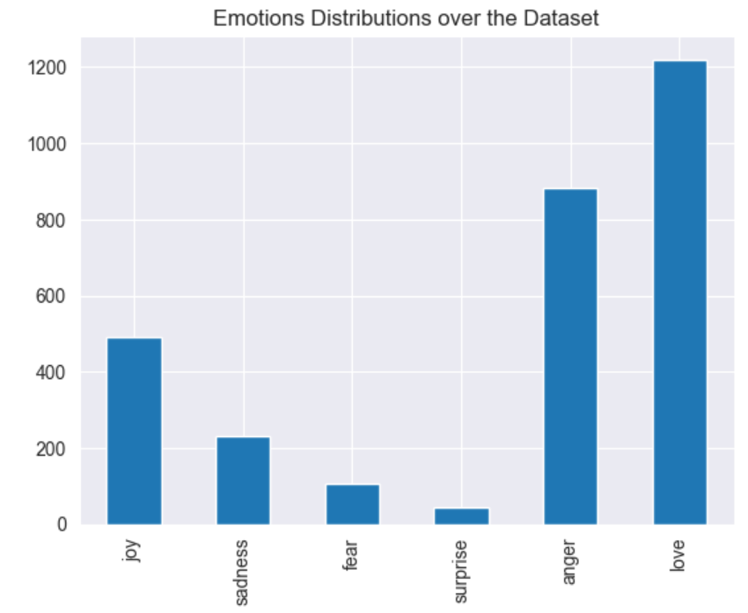
DATA ANALYSIS
The classes are not equally distributed. We have a large gap between the less represented class, Surprise, and the most represented one, Love

Slide 5
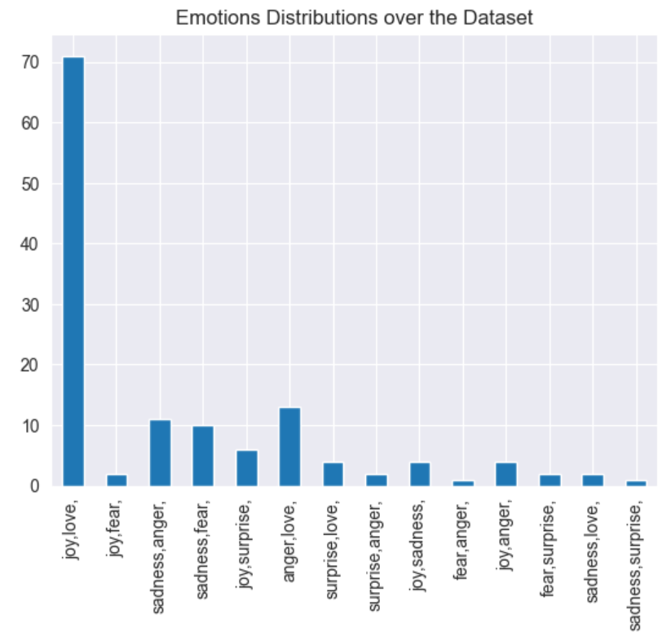
DATA ANALYSIS
We count the number of sentences with more than one sentiment.
As we can see from the plot, joy and love is the more frequent couple, understandably, but we have also some strange couple of sentiments, as joy and sadness, or joy and fear, in some sentences.

Slide 6
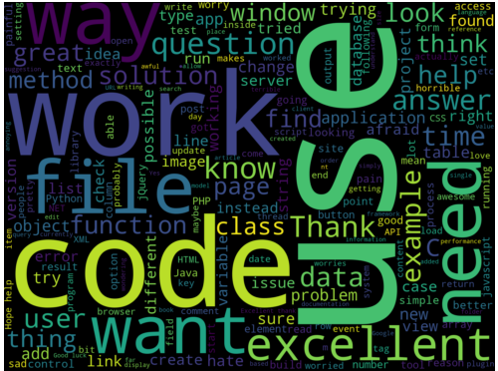
DATA ANALYSIS
We have a total of 4800 sentences labeled on 6 sentiments.
'love' is the more represented one, with 1200 samples, but we have some sentiments, like surprise and fear, that have less than 200 samples, maybe not too much for training a classification model.
Even considering the most represented ones, the dataset is highly unbalanced, so we will use some balancing techniques.
Sentences have a mean number of words of about 37
133 sentences have been labeled with more than one sentiment, sometimes correlated, as love and joy, sometimes not.
This may be due to the fact that sentiments and feelings change a lot from one to another, and so the samples in our dataset.

Slide 7
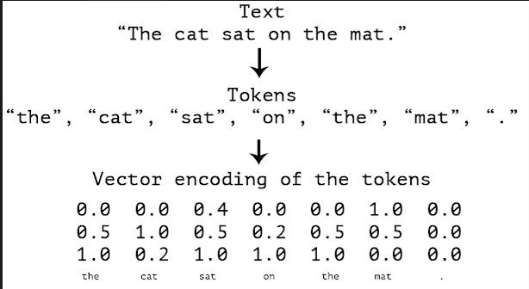
FEATURE EXTRACTION
Word vectors, or word embeddings, are vectors of numbers that provide information about the meaning of a word, as well as its context.
Vector averaging means that the vector of multiple tokens is insensitive to the order of the words. The vector will be a one-dimensional Numpy array of float numbers and has 300 dimensions.
The sentence vector is the same shape as the word vector because it is made up of the average of the word vectors over each word in the sentence.

Slide 8
PIPELINE
We create a pipeline in wich we have 3 steps:
the WordVectorTransformer class previously created, that will preprocess the text
a SMOTE instance, that will apply a SMOTE algorithm to our data. We tried a RandomUnderSampler but we find SMOTE better.
One instance of the chosen classifiers to compare

Slide 9
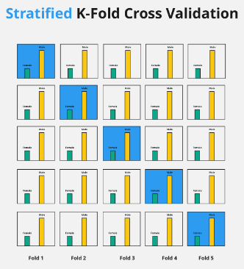
CROSS VALIDATION
we use cross validation for evaluating. The StratifiedKFold function returns k=5 folds preserving the same percentage of samples for each class.

Slide 10
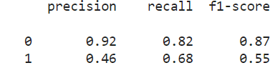
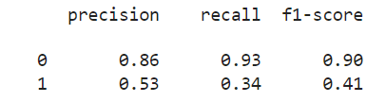
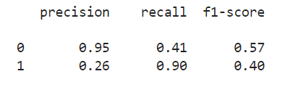
CLASSIFIER COMPARISON
We will train different classification model such as SVM, Random Forest and KNN, and try to predict if some comments contain a specified sentiment. So, we will have different binaries model. This choice is due to the low number of data and samples for each class.
Let’s see for the emotion ‘anger’:
SVM→
RANDOM FOREST →
KNN→

Slide 11
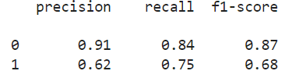
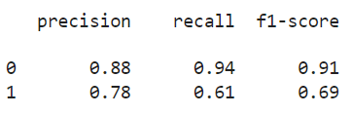
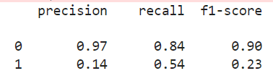
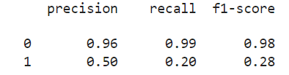
For the emotion ‘love’:
SVM→
RANDOM FOREST→
For the emotion ‘sadness’:
SVM→
RANDOM FOREST→

Slide 12
CONCLUSIONS
For our study case, we think it's important to consider the single precision and recall score for each class, more than the single accuracy value, thus we used classification reports to evaluate each run of cross validation. We could use macro averages for comparing models. Generally, the SVM perform better. The Random Forest sometimes has good scores too and KNN does not perform well as the previous ones

Slide 13
